Slide 1
Review 3 College News Report
Presenters
2010030071 - Jyothin Movva
2010030151 - Satyavarsan K S
2010030040 - Devaraj Acharya
2010030393 - Haneesh Malepati

Slide 2
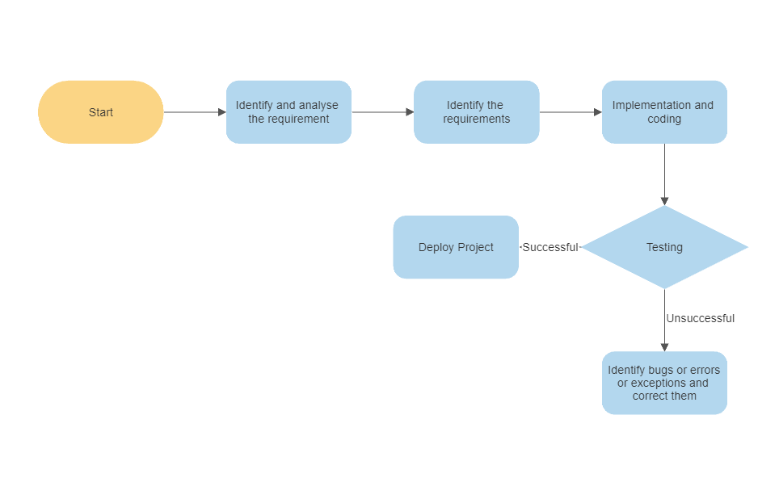
Flowchart

Slide 3
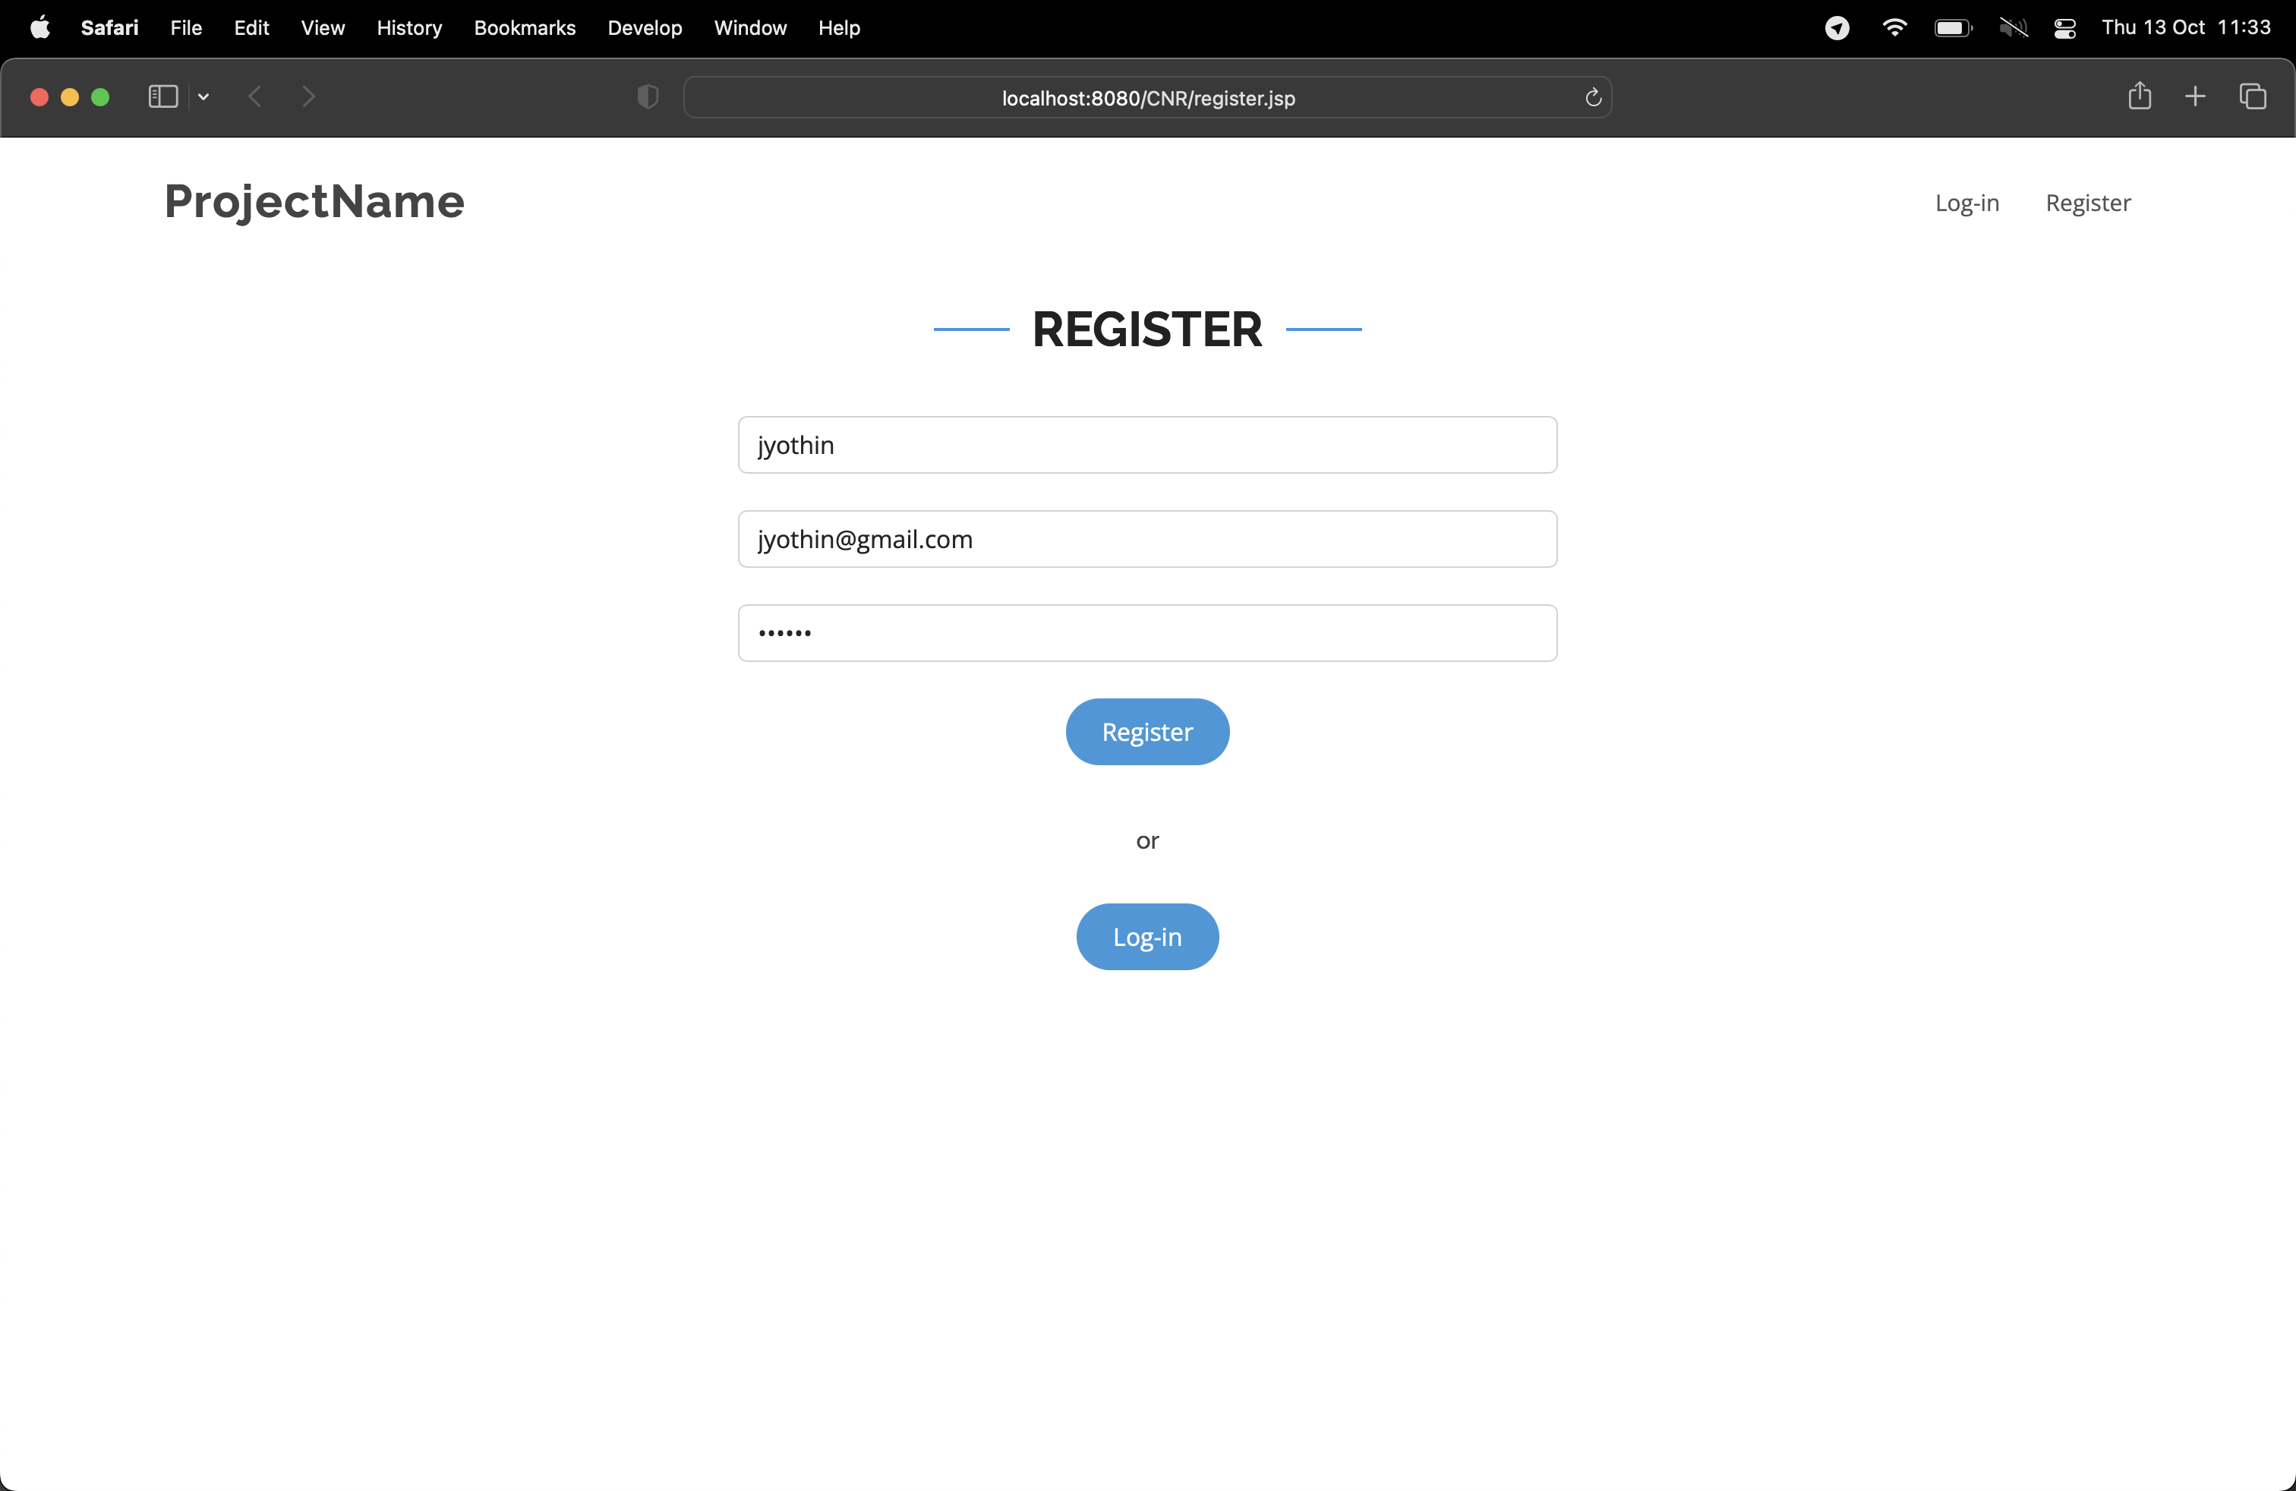
Work Progress (Register Page)

Slide 4
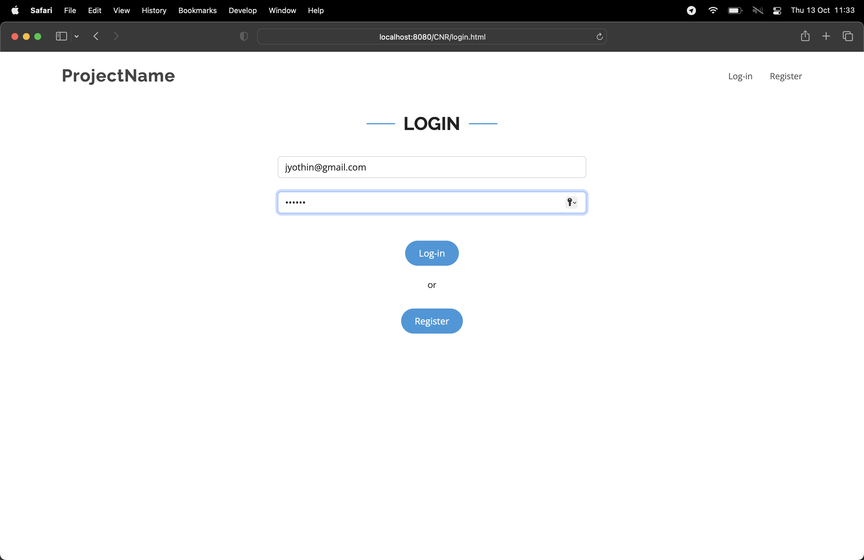
Work Progress (Login Page)

Slide 5
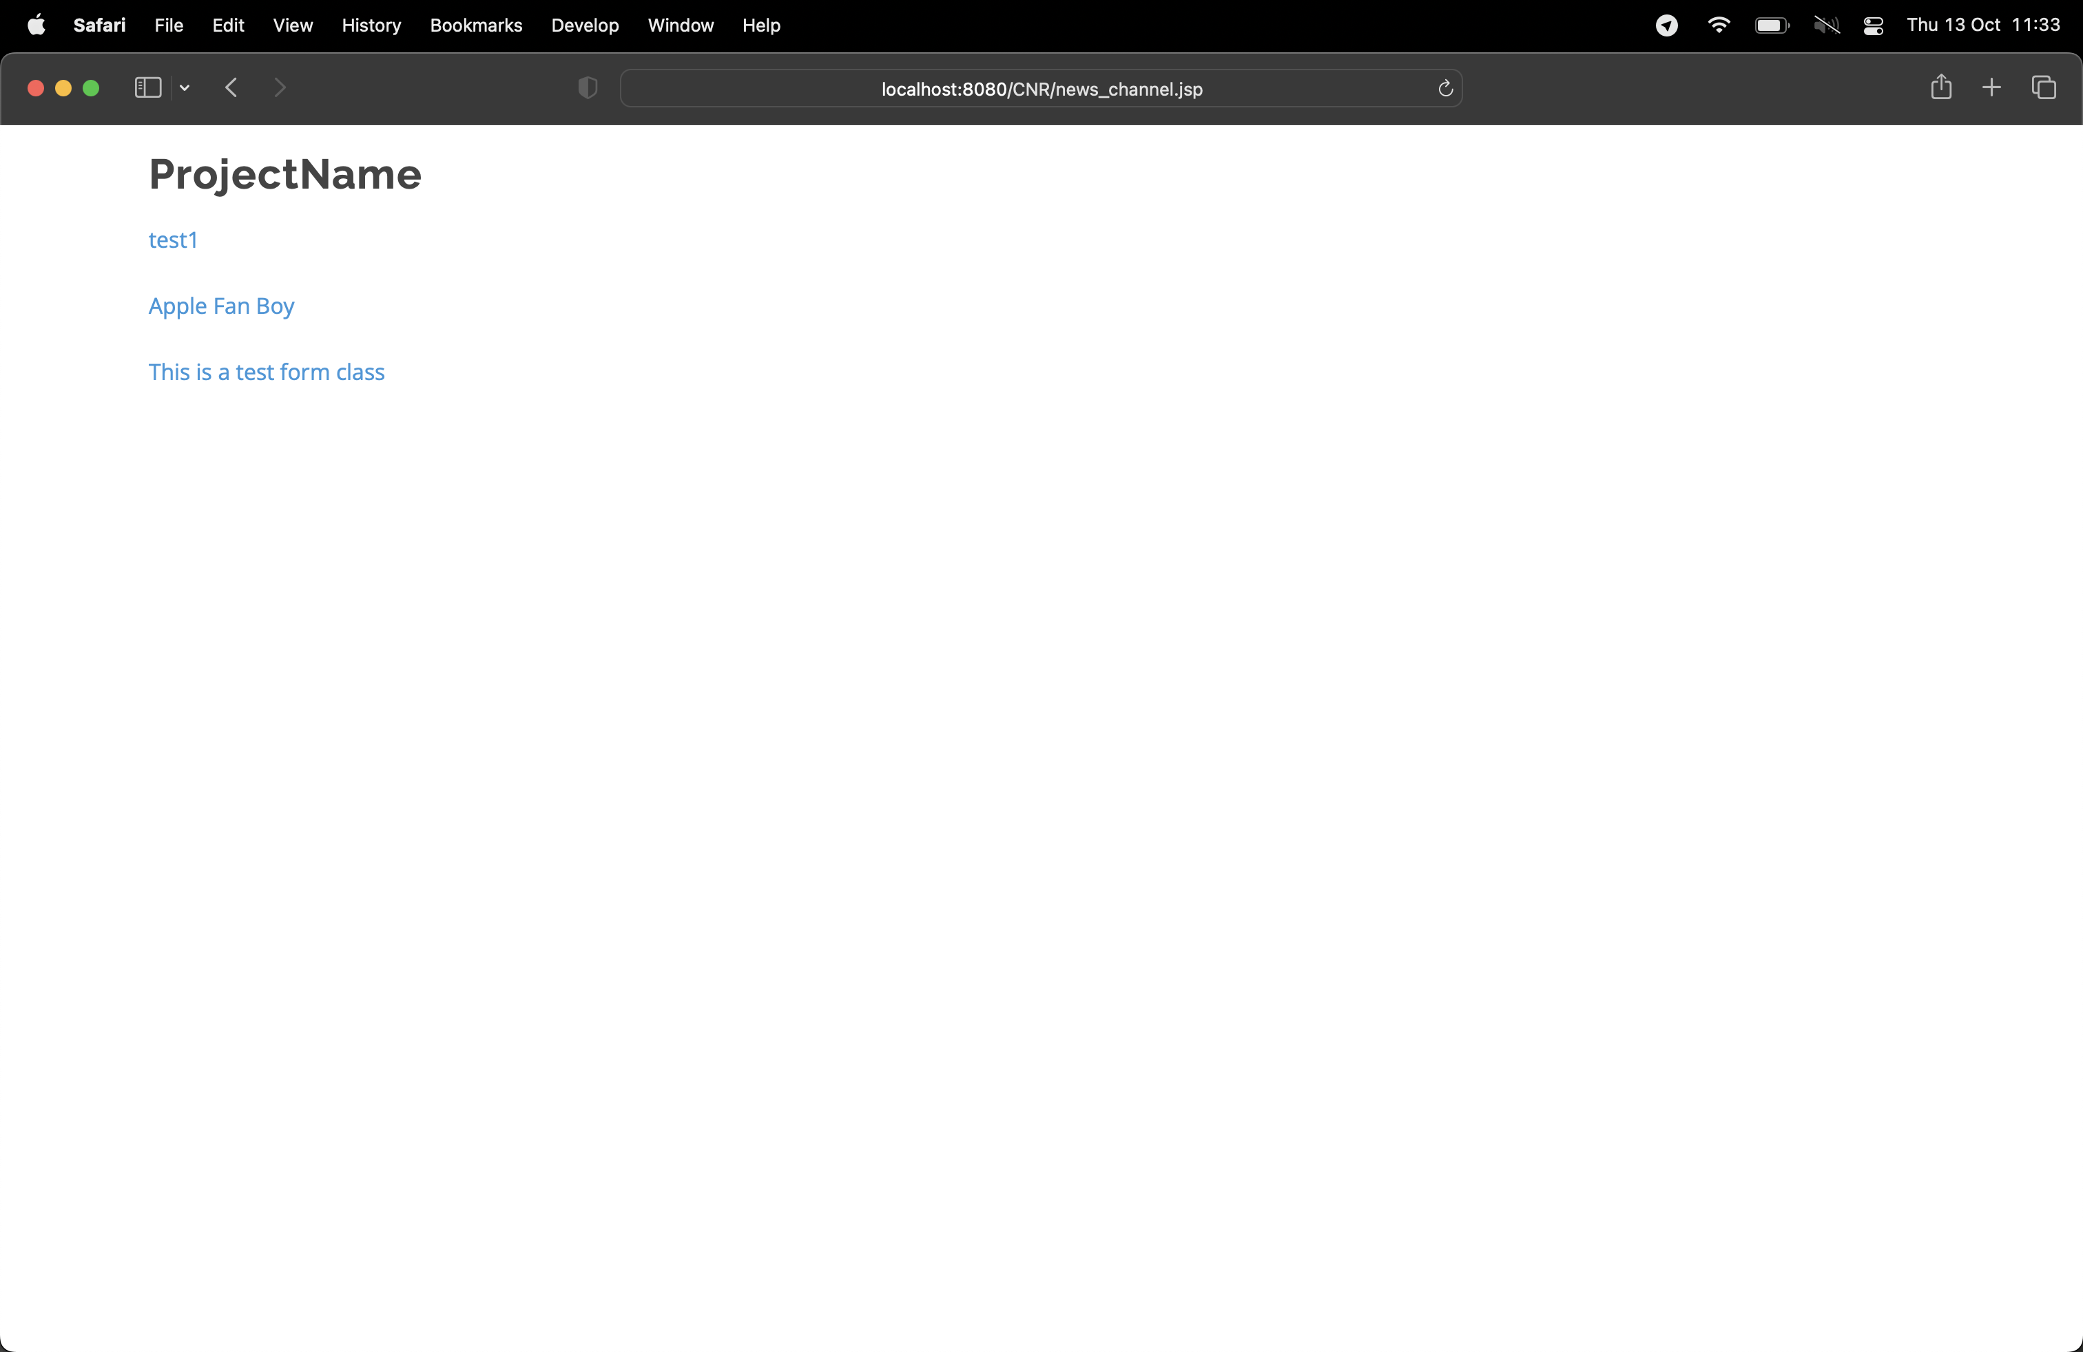
Work Progress (News Channel)

Slide 6
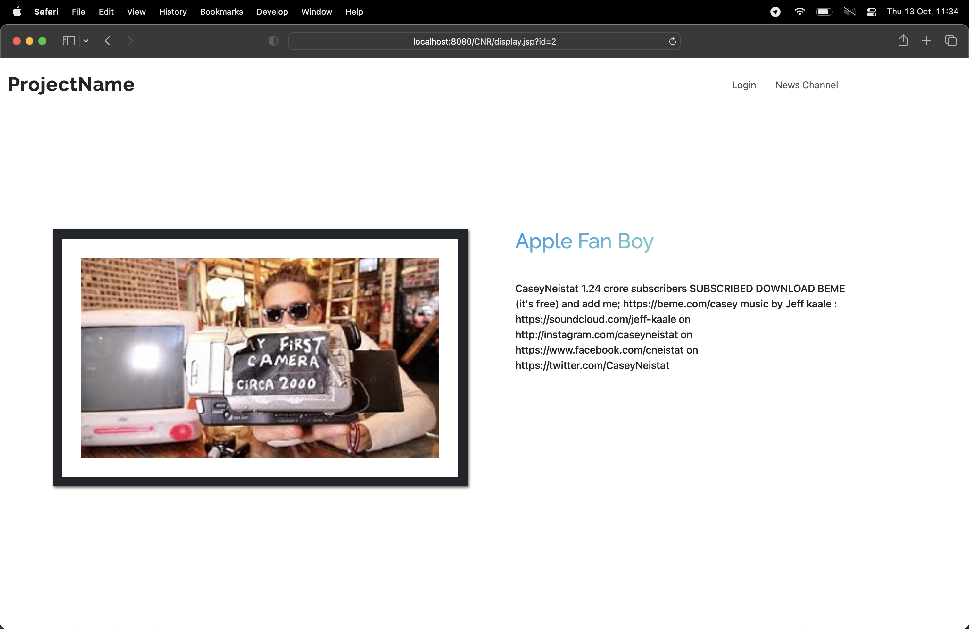
Work Progress (News Article Page)

Slide 7

Work Progress (News Entry Function)

Slide 8
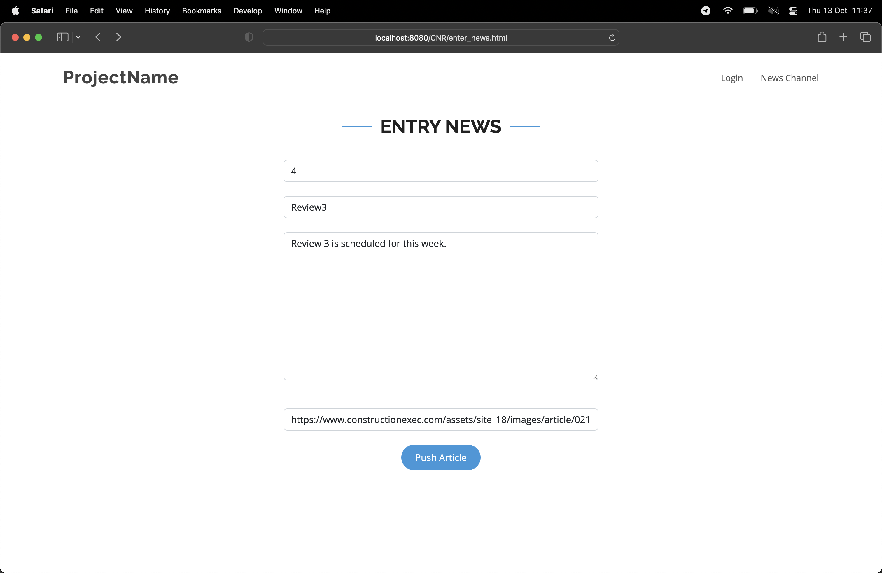
Work Progress (News Entry Function)

Slide 9
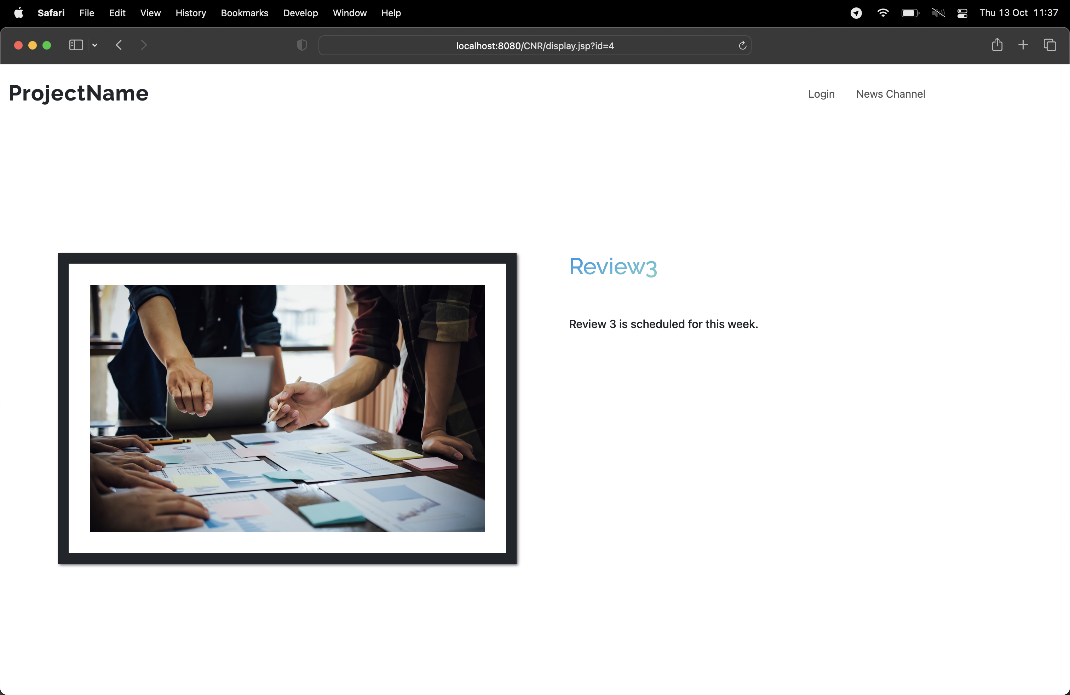
Work Progress (News Entry Function)

Slide 10
THANK YOU

